Slide 1

CRICKET WORLD CUP DATABASE MANAGEMENT SYSTEM
Team 4:
Bhuvan M C 01fe19bcs275
Shreehari T Alagawadi 01fe19bcs279
Supriya Khemalapure 01fe19bcs290
Raghavendra A Hallyal 01fe19bcs304

Slide 2

Problem Statement
This project aims to design and implement the database to maintain the data related to cricket World Cup.

Slide 3
Objectives
Public should be able to get information about cricket World cup.
It shall provide information about the various teams, players ,coaches, umpires, captains, stadiums, matches, their results.
It shall provide options to schedule or reschedule or cancel the matches.
It shall allow updating match results after each match.
It shall allow admin to disqualify the player or a team.

Slide 4
Data Requirements
Team is an entity type which has many attributes like CountryName which uses the data type varchar2. Every team has been given a Team ID which is the primary key which is of data type varchar2. Number of Batsmen and Number of Bowlers are of the data type number.
Players is an entity type which has an attribute Player Name which is of the data type varchar2. It has a primary key, Player ID . It has a type of player (batsman or bowler or all-rounder) and a composite attribute, Number of matches played, which comprises of Number of Test Matches, Number of T20 Matches and Number of ODIs.
If player is a Batsman the attributes – Number of sixes hit, Number of Fours hit, the batting average, and the total runs scored will have values . All of these attributes are of the data type number.
If player is a Bowler the attributes – type of bowler (Pace or spin) with varchar2 data type , Highest speed , number of wickets and economy will have values.

Slide 5
Umpire is an entity type which has the attributes name and country of origin of data type varchar2. The primary key of this is Umpire Id which is of varchar2 data type. It also has attributes Number of matches and Experience of data type number.
Coach is an entity type with a primary key, Coach ID, of data type varchar2. It also has coach name, coach country and type (batting coach or bowling coach) of data type varchar2. Experience of datatype number.
Captain is a weak entity type with attributes like Name of datatype varchar2. Number of years of captaincy , Number of wins and Number of International trophies are also attributes of this table of data type number.
Matches is a strong entity type with a primary key, match ID of varchar2 data type. It has attributes like Team1 Name, Team2 Name of data type varchar2. Match date and time is an attribute which uses the data type timestamp.

Slide 6
Result is an entity type with a primary key, resultID of varchar2 data type. It has attributes like Winner Team , Loser Team and man of the match, WonByRuns .
Stadium is an entity type with a primary key stadiumId , stadium name, pitch type of varchar2. Number of matches in that stadium is of datatype number.
Points table is an entity type with attributes, Number of Draws , Number of Wins and Number of Losses , Team Ranking , derived attribute Total matches played , Runrate , Points.

Slide 7

Functional Requirements
1. RETRIEVAL OF DATA BY USER:
Any users must be able to retrieve the information they want.
• View all teams.
• View all players of a team.
• View all batsmen in the tournament.
• View all bowlers in the tournament.
• View all match reports .
• View present statistics of a player .
• View coach details.
• View umpire details.
• View Match details.
• View ranking of each team and view many more datas.

Slide 8
Functional Requirements Continued….
ADMINISTRATOR
2. DISQUALIFICATION OF A PLAYER OR A TEAM .
3. SCHEDULING MATCH BETWEEN 2 TEAMS ON SPECIFIC DATE AND TIME.
4. UPDATING OF RESULT OF THE MATCHES SCHEDULED.
5. RANKS SHOULD BE AUTOMATICALLY UPDATED WHEN RESULT IS UPDATED

Slide 9
Relations
1) Team has Players (1:N)
A cricket player can play in only one team but a team can have many players in it but a team must have players in it.
2) Team is Managed by Coach(1:N)
Coach can manage a single team, but each team can have many coaches (like batting coach, fielding coach, bowling coach). But it is compulsory for a team to have a coach. So, the relationship is 1:N .
3) Team plays match(M:N)
Team can play many matches and a match can be played by two teams. So, the relationship is M-N.
4) Team has a rank in Points table(1:1)
5) Team has a Captain(1:1)
Each team lead by a single caption.

Slide 10
6) Matches are umpired by Umpire(M:N)
An umpire can umpire in many matches and a match can have two umpires. So, the relationship is M-N. Team headed by a Captain (1-1) A team has 1 captain and a captain is from single team only. So the relationship is 1-1.
7) Matches are played in a Stadium(N:1)
N matched can be done in a 1 stadium.
8) Match has a result(1:1)
9)A player is man of the match in match result(1:1)
10) A team is winner in match result.(1:1)

Slide 11
E-R diagram
Participations of an entities is represented in ER diagram as shown below.
Here entity 1 is total participating and entity 2 is partially participating .
Relationship type
Entity type 1
Entity type 2

Slide 12
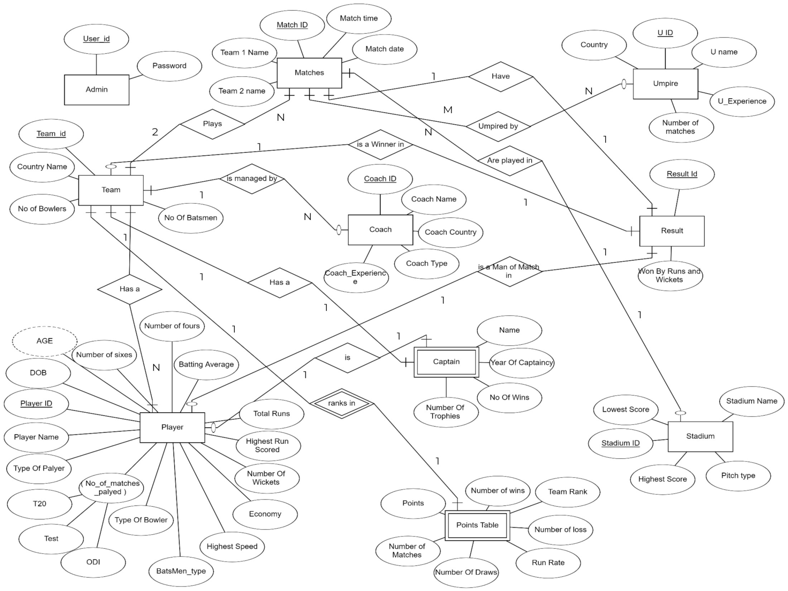

Slide 13
If we consider Player table, player is either a batsman or bowler or all rounder Hence some values becomes null if player is only batsmen or only bowler.
Player { player id, player name, dob, type of player, no of tests, no of matches, team id, batsman type, number of sixes, number of fours, total runs, highest runs, batting average, bowler type, number of wickets, highest speed, economy }
To avoid null values Player table is further divided into 3 tables
Player { player id, player name, dob, type of player, no of matches, team id }
Batsman { player id, batsman type, number of sixes, number of fours, total runs, highest runs, batting average }
Bowler { player id, bowler type, number of wickets, highest speed, economy }

Slide 14
Normalization
TEAM, PLAYER, BATSMAN, BOWLER, UMPIRE, COACH, CAPTAIN, MATCHES, RESULTS, STADIUM, POINTS TABLE, UMPIRED BY
INF :
Player { player id, player name, dob, type of player, no of matches, team id }
Player table has a composite attribute no of matches comprising of no of tests, no of t20s, no of ODIs . This violates 1NF form.
Divide composite value into simple attributes - no of tests, no of t20s, no of ODIs .
Player { player id, player name, dob, type of player, no of tests, no of t20s, no of ODIs, team id }
Since other tables doesn’t contain any multi valued attributes it’s in 1NF.

Slide 15
In most of the tables there is no multiple key attributes. So, there is no need to check whether any of the non key attributes depend partially on the key attributes of the entity. In captain table there is no partial dependency. Therefore, the schema is in 2NF.
There is no transitive dependency in any tables.
Schema is reduced to BCNF because only key is determining the other attributes. Hence the schema remains same after normalization.

Slide 16
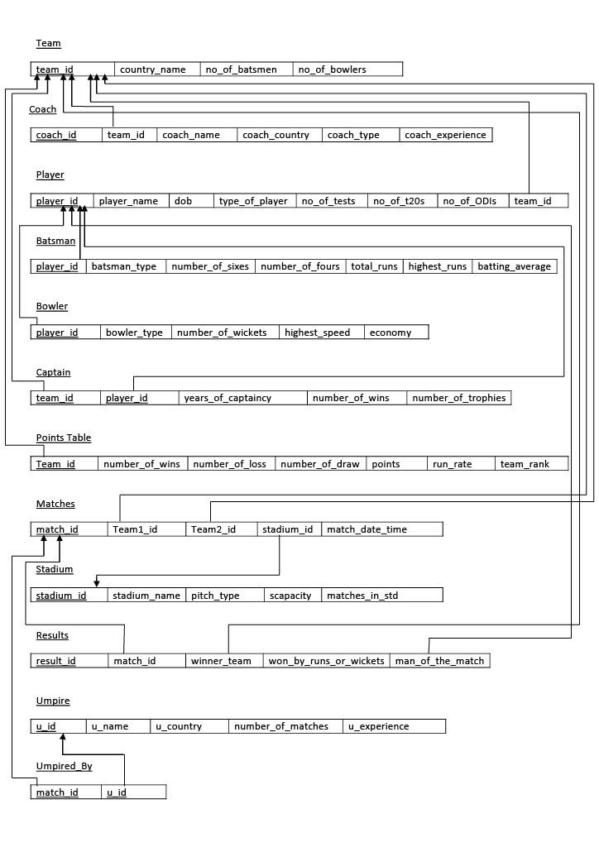
Relational Schema

Slide 17
Table Description

Slide 18
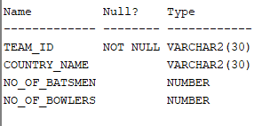
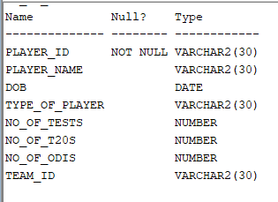
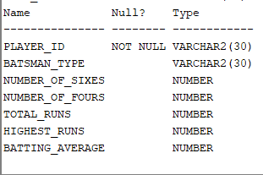
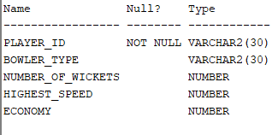
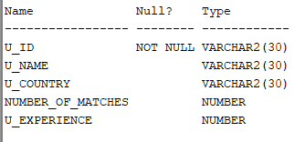
Player
Team
Batsman
Bowler
Umpire

Slide 19
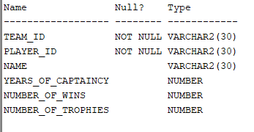
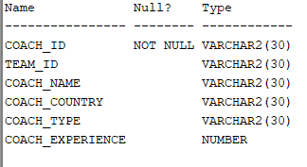
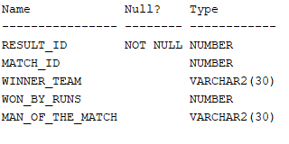
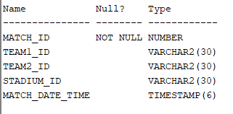
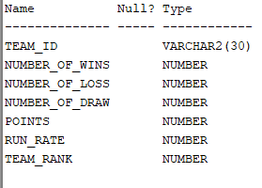
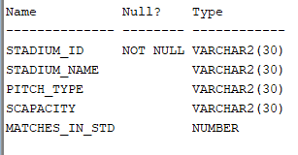

Coach
Captain
Result
Matches
Points
Stadium
Umpired By

Slide 20


Queries along with Problem statements along with
Output-Snippets

Slide 21


Queries
SQL-Queries
Set Theory & Logical Operators , Equijoin Operations
Aggregate Functions, Group by and Having Clause
Views, single row , Multiple row & Correlated operations
2. PL/SQL Queries
Triggers
Cursors
Procedures
Functions

Slide 22
FRONT-END GUI

Slide 23
THANK YOU

